Slide 1
Testing. Doctest
Notes:
* https://docs.python.org/3.6/library/doctest.html

Slide 2
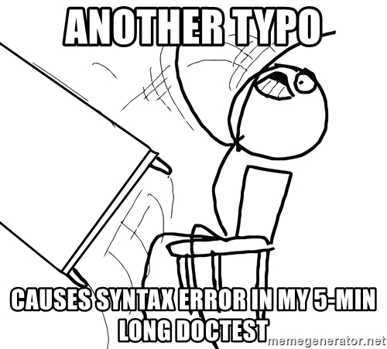
To do or not to do?
The doctest module searches for pieces of text that look like interactive Python sessions, and then executes those sessions to verify that they work exactly as shown.
Notes:
Unittest are meaning

Slide 3
Usage
There are several common ways to use doctest:
To check that a module’s docstrings are up-to-date by verifying that all interactive examples still work as documented.
To perform regression testing by verifying that interactive examples from a test file or a test object work as expected.
To write tutorial documentation for a package, liberally illustrated with input-output examples. Depending on whether the examples or the expository text are emphasized, this has the flavor of “literate testing” or “executable documentation”.

Slide 4
Example
If you run doc_base_example.py directly from the command line, doctest works its magic:
There’s no output! That’s normal, and it means all the examples worked. Pass -v to the script, and doctest prints a detailed log of what it’s trying, and prints a summary at the end:
$ python example.py
$
$ python example.py –v
Trying:
factorial(5)
Expecting: 120 ok
Trying:
[factorial(n) for n in range(6)]
Expecting:
[1, 1, 2, 6, 24, 120] ok
Notes:
And so on, eventually ending with:
Trying: factorial(1e100) Expecting: Traceback (most recent call last): ... OverflowError: n too large ok 2 items passed all tests: 1 tests in __main__ 8 tests in __main__.factorial 9 tests in 2 items. 9 passed and 0 failed. Test passed. $

Slide 5
Example
The simplest way to start using doctest (but not necessarily the way you’ll continue to do it) is to end each module M with:
Running the module as a script causes the examples in the docstrings to get executed and verified: python ModuleName.py
A –v flag add detailed report of all examples tried is printed to standard output, along with assorted summaries at the end.
if __name__ == "__main__":
import doctest
doctest.testmod()
Notes:
python M.py
This won’t display anything unless an example fails, in which case the failing example(s) and the cause(s) of the failure(s) are printed to stdout, and the final line of output is ***Test Failed*** N failures., where N is the number of examples that failed.

Slide 6
Example
Another simple application of doctest is testing interactive examples in a text file. This can be done with the testfile() function:
That short script executes and verifies any interactive Python examples contained in the file example.txt. The file content is treated as if it were a single giant docstring; the file doesn’t need to contain a Python program!
import doctest
doctest.testfile(“test_from_text.txt")

Slide 7
Example
doctest.DONT_ACCEPT_BLANKLINE
By default, if an expected output block contains a line containing only the string <BLANKLINE>, then that line will match a blank line in the actual output. Because a genuinely blank line delimits the expected output, this is the only way to communicate that a blank line is expected. When DONT_ACCEPT_BLANKLINE is specified, this substitution is not allowed.
doctest.NORMALIZE_WHITESPACE
When specified, all sequences of whitespace (blanks and newlines) are treated as equal. Any sequence of whitespace within the expected output will match any sequence of whitespace within the actual output. By default, whitespace must match exactly. NORMALIZE_WHITESPACE is especially useful when a line of expected output is very long, and you want to wrap it across multiple lines in your source.

Slide 8
Example
doctest.ELLIPSIS
When specified, an ellipsis marker (...) in the expected output can match any substring in the actual output. This includes substrings that span line boundaries, and empty substrings, so it’s best to keep usage of this simple. Complicated uses can lead to the same kinds of “oops, it matched too much!” surprises that .* is prone to in regular expressions.
doctest.IGNORE_EXCEPTION_DETAIL
When specified, an example that expects an exception passes if an exception of the expected type is raised, even if the exception detail does not match. For example, an example expecting ValueError: 42 will pass if the actual exception raised is ValueError: 3*14, but will fail, e.g., if TypeError is raised.
Notes:
Модуль doctest позволяет проверить реализацию функции на соответствие записанному сеансу интерпретатора.
Плюсы:
доступен в стандартной библиотеке,
решает задачу тестирования для небольших проектов,
доктесты их легко читать,
примеры кода в документации всегда актуальны.
Минусы:
доктесты требуют, чтобы у результата было содержательное строковое представление,
длинные доктесты ухудшают читаемость документации,
нет способа запустить подмножество доктестов,
если в середине доктеста произошла ошибка, оставшаяся часть не выполнится.

